Slide 1
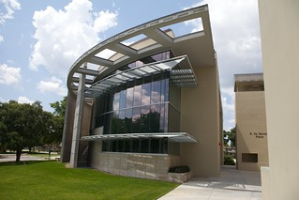
Florida v. J.L.
Justice Teaching Center for Civic Learning

Slide 2
What would you look for?
If you were responsible for selecting all of the judges in Florida, what would you look for?
Knowledge
Skills
Disposition/Qualities

Slide 3
How are judges different from other elected officials?
Other elected officials make decisions based on the needs/desires of their constituents or voters, their own beliefs, special interest groups, or their political party’s agenda.
Judges should make decisions based on the law and precedent. They should not be influenced by politics, special interest groups, other external influences. They should be fair and impartial.
Notes:
Differentiate between judges and other elected officials such as legislators. Make sure the audience understands that this is the way our system is designed.

Slide 4
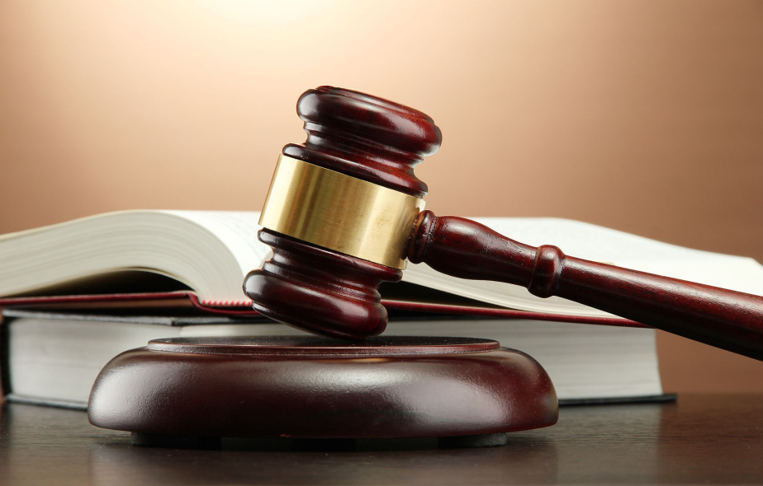
How should judges make decisions?
Would you want a judge to make a decision based on the law or how the public might react to the decision?
Should judges do what is legally right or should they do what is popular?

Slide 5
Judicial Decision Making
What provides the basis for legal decisions:
Constitution
Statutes
Legal reasoning
Precedent: prior cases
Higher court decisions
Code of Judicial Conduct
Decisions may be appealed to a higher court.

Slide 6
You Be the Judge
Today, you will be a justice on the U.S. Supreme Court and decide a real case.

Slide 7
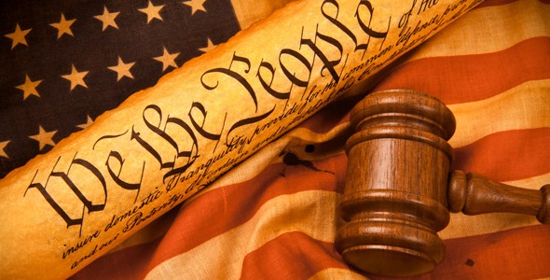
But first…
You need to know the Fourth Amendment to the U.S. Constitution.

Slide 8
Fourth Amendment United States Constitution
“The right of the people to be secure in their persons, houses, papers, and effects, against unreasonable searches and seizures, shall not be violated, and no warrants shall issue, but upon probable cause, supported by oath or affirmation, and particularly describing the place to be searched, and persons or things to be seized.”

Slide 9
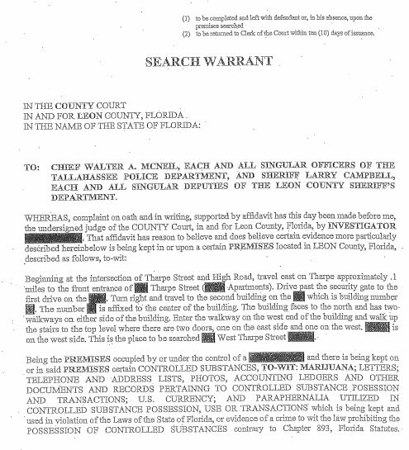
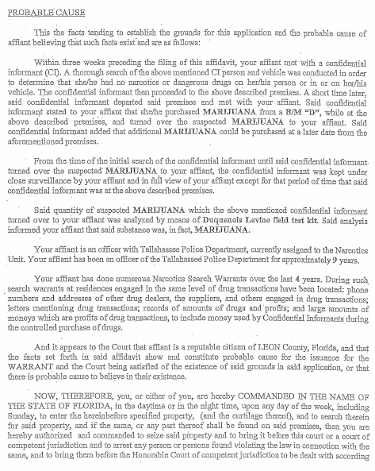
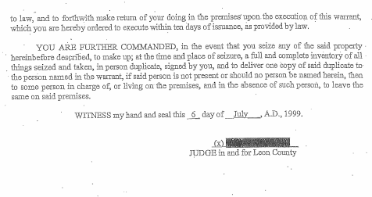
Sample Warrant

Slide 10
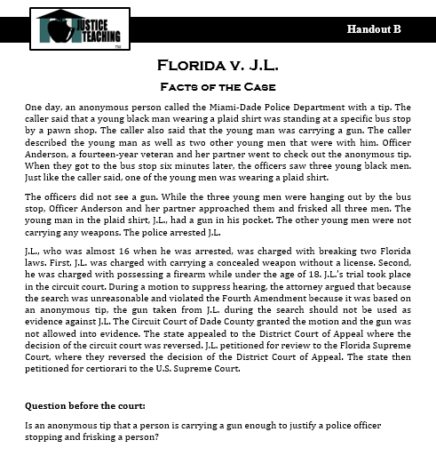
The Anonymous Tip
Read and highlight or circle the important facts.
Notes:
Have class read the facts of the case and highlight important facts. No personal opinions.

Slide 11
Florida’s Court Structure
Florida Supreme Court
District Courts
of Appeal
Circuit Courts
County Courts
Notes:
Review structure and function of the courts in Florida.

Slide 12
The Trial Court & Motion to Suppress
J.L. will appear in circuit court before a trial judge.
What is a motion to suppress?
A motion to suppress evidence is a request by a defendant that the judge exclude certain evidence from trial.
Notes:
Juvenile case. Circuit court. No jury.

Slide 13
What else should a judge know?
In addition to the Fourth Amendment, what else might we need to know?
Other similar cases and how they were decided
Case precedent: Terry v. Ohio
How are the facts in Terry v. Ohio similar or different from the J.L. case?
Notes:
Review facts of Terry v. Ohio briefly.

Slide 14
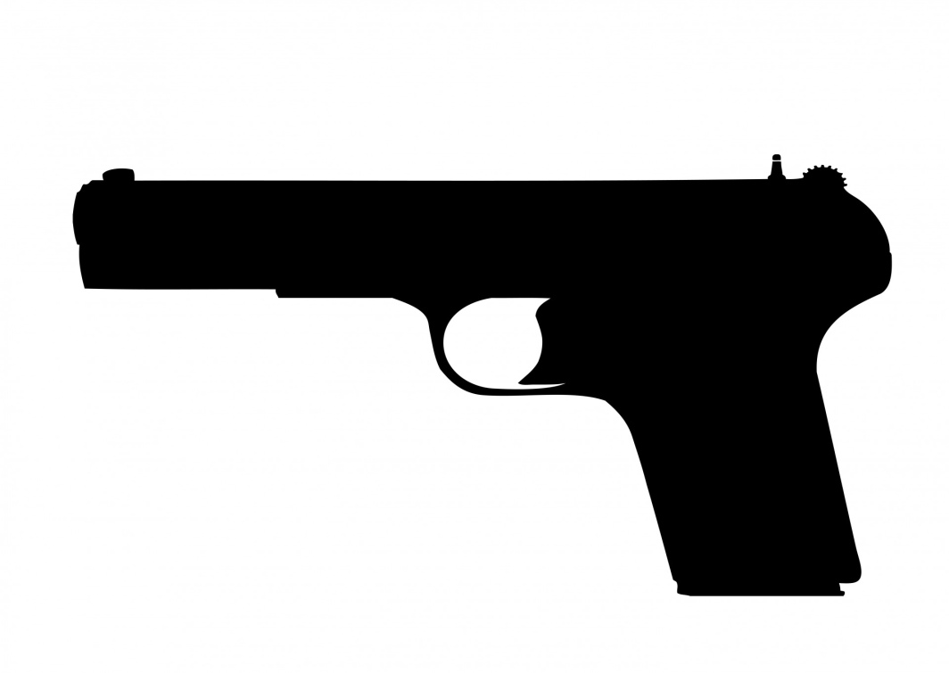
How would you apply to the J.L. case?
Should the gun be suppressed as evidence in the J.L. case?
Yes or No?
Why or why not?

Slide 15
The Case Through the Courts
What did the trial court decide?
Circuit Court: Granted the motion to suppress the gun as evidence; a Fourth Amendment violation had occurred.
Notes:
One trial judge ruled in favor of JL.. What was the legal reasoning.

Slide 16
How does a case progress through the courts?
Some examples:
Appeals
Petition for review
Jurisdiction: Authority of courts to hear certain cases
Mandatory: cases that must be heard
Discretionary: cases that may be heard
Notes:
Distinguish briefly the differences and how cases may come to the Supreme Court.

Slide 17
The Case Through the Courts
What did the court decide?
Florida Supreme Court
District Court of Appeal: Reversed the decision of the trial court; no Fourth Amendment violation had occurred. J.L. petitioned for review to the Florida Supreme Court
Circuit Court: Granted the motion to suppress the gun as evidence; a Fourth Amendment violation had occurred. Appealed to the Third DCA.
Notes:
Three judges at the 3rd DCA ruled in favor of the State of Florida.

Slide 18
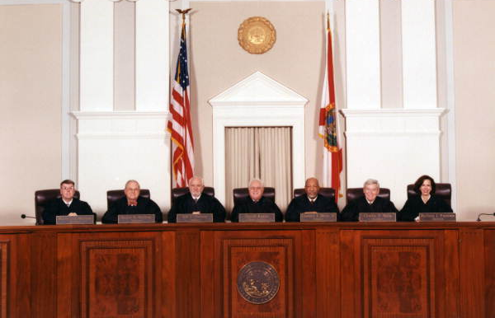
The Florida Supreme Court (1998)
Agreed with trial court. Search was unreasonable. Violation of Fourth Amendment. 4-2 decision in favor of J.L.
Notes:
https://www.floridamemory.com/items/show/47220
Only six justices heard the case. 4-2 decision in favor of JL

Slide 19
The Case Through the Courts
What is a Writ of Certiorari?
U.S. Supreme Court
Petition for Writ of Certiorari
Florida
Supreme Court
Fourth Amendment violation occurred; evidence suppressed
District Court of Appeal: Reversed the decision of the trial court; no Fourth Amendment violation had occurred. J.L. petitioned for review to the Florida Supreme Court
Circuit Court: Granted the motion to suppress the gun as evidence; a Fourth Amendment violation had occurred
Notes:
Certiorari is the name given to certain appellate proceedings for re-examination of actions of a trial court, or inferior appeals court.
Petition for Writ of Certiorari. (informally called "Cert Petition.") A document which a losing party files with the Supreme Court asking the Supreme Court to review the decision of a lower court. It includes a list of the parties, a statement of the facts of the case, the legal questions presented for review, and arguments as to why the Court should grant the writ. It is not mandatory for the Court to accept. This is discretionary.
Writ of Certiorari. A decision by the Supreme Court to hear an appeal from a lower court.
Cert. Denied. The abbreviation used in legal citations to indicate that the Supreme Court denied a Petition for Writ of Certiorari in the case being cited.

Slide 20
Now you are a Justice on the U.S. Supreme Court
Here is the question before the Court…

Slide 21
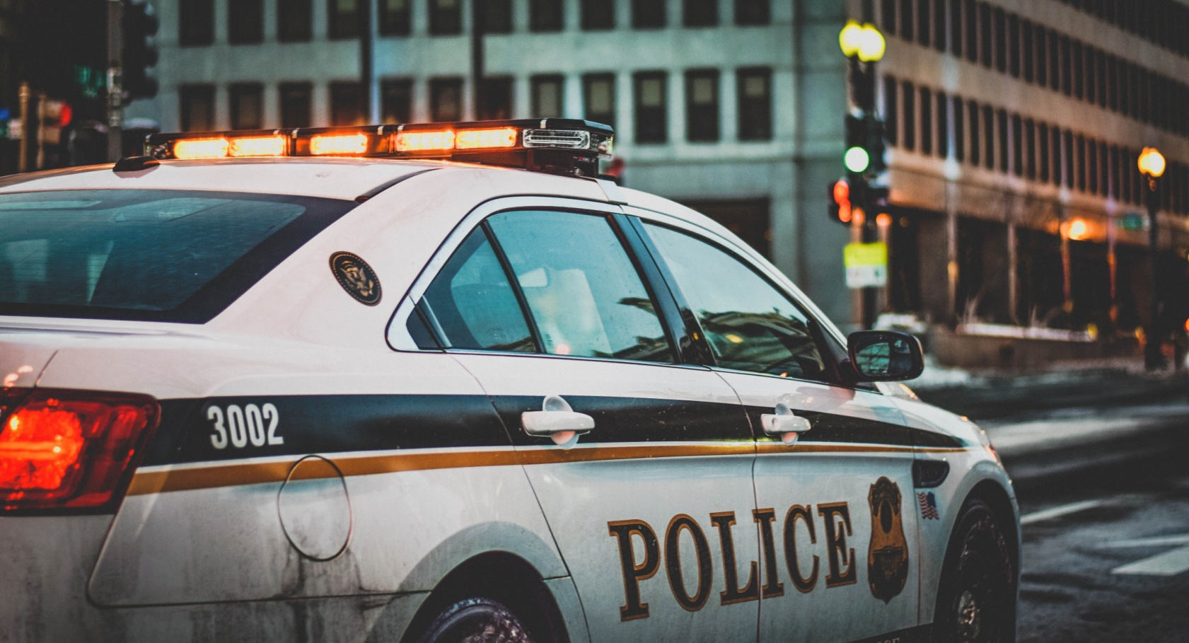
The Question Before the Court
Is an anonymous tip that a person is carrying a gun sufficient (enough) to justify a police officer stopping and frisking a person?

Slide 22
The Anonymous Tip
Individually answer the question.
Yes or No based on the facts of the case, the Constitution, and case precedent.
Give 3 reasons in writing.

Slide 23
The Anonymous Tip
If you answer “Yes” – you are deciding in favor of the State of Florida
________________________
If you answer “No” you are deciding in favor of J.L.

Slide 24
The Question Before the Court
Is an anonymous tip that a person is carrying a gun sufficient (enough) to justify a police officer stopping and frisking a person?

Slide 25
Court Conference
Assemble into Groups of 5
Choose a Chief Justice
Chief Justice Maintains Order
Poll the Justices. How did each one answer the question and why?
Try to come to a unanimous decision.

Slide 26
The Opinion of Your Court
After each Court decides:
Bring the Chief Justices to the front of the room to report on the decision of each group
Tally results and announce

Slide 27
The U.S. Supreme Court
What did the U.S. Supreme Court decide and why?

Slide 28
Decision in Florida v. J.L.: Anonymous tip is not sufficient
From the opinion authored by Justice Ruth Bader Ginsburg:
"All the police had to go on in this case was the bare report of an unknown, unaccountable informant who neither explained how he knew about the gun nor supplied any basis to believe he had inside information."
Notes:
Unanimous decision agreed with Florida Supreme Court in favor of JL. An anonymous tip without more is not enough for police to stop and frisk someone. Review relevant quotes from decision and include dissent.

